Slide 1
Vacation and vacation Payout
Managing Vacation Requests and Payouts in Workday for Canada
Note*
The screenshots contained in this training deck are in English only. Workday does have the ability to display in French based on your preference.

Slide 2
Vacation
There are three ways to enter an employees vacation time/dollars in Canada:
The employee can request paid vacation hours through time off and they will be paid for them, decrementing their vacation hours and dollars balances
The employee or their manager can request unpaid vacation hours for the employee, which will decrement the vacation hours balance
The employee can ask for a one time payment that will pay them vacation dollars, which will decrement their vacation dollar balance and not affect hours
Notes:
Click on the Team Time worklet on your home screen.

Slide 3
Note: This Job Aid is specifically for vacation requests and payouts for Canada; for other types of time offs and one time payments, please refer to those specific job aids

Slide 4
Entering Time Off Hours Through Time Off (Paid and Unpaid)

Slide 5
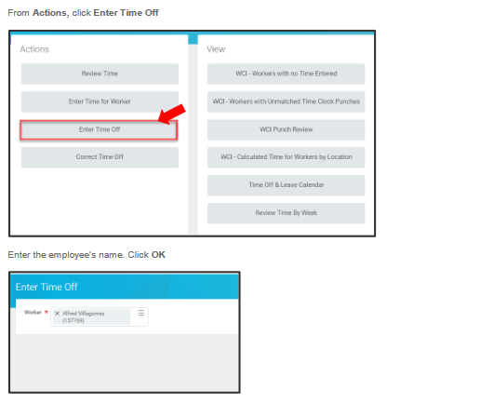
Request Time Off: Enter Time Off
Notes:
From the search bar, enter the “request one time payment” task. You can also access this task from the Employee’s profile by clicking Actions and hovering over Compensation. Click Request One-Time Payment from the drop-down menu.

Slide 6
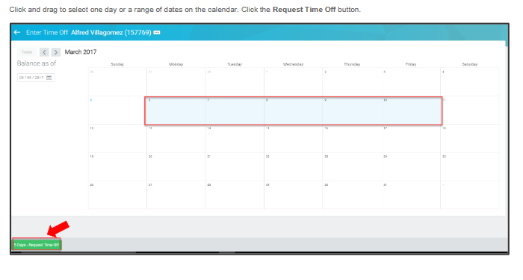
Request Time Off: Enter Time Off
Notes:
From the search bar, enter the “request one time payment” task. You can also access this task from the Employee’s profile by clicking Actions and hovering over Compensation. Click Request One-Time Payment from the drop-down menu.

Slide 7
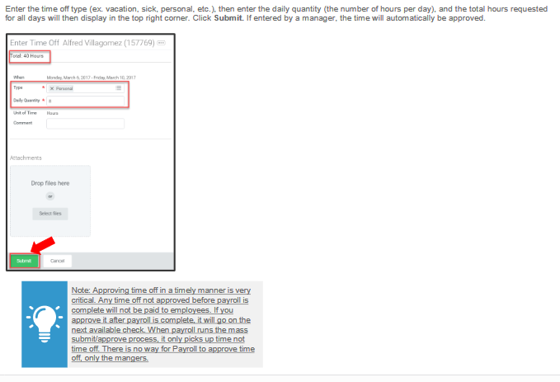
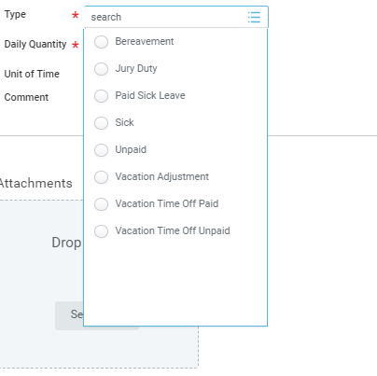
Request Time Off: Enter Time Off
Enter the time off type (Vacation Time Off Paid, Vacation Time Off Unpaid) then enter the daily quantity (the number of hours per day,) and the total hours requested for all days will then display in the top right quarter. Click Submit. If entered by a manager, the time will automatically be approved.
Note: Choose Vacation Time Off Paid to pay the
Vacation hours on the cheque, and Choose
Vacation Time Off Unpaid to just report the hours
Taken without having them being paid.
Note: Approving time off in a timely manner is very
critical. Any time off not approved before payroll is
complete will not be paid to employees. If you
approve it after payroll is complete, it will go on the
Next available cheque. When payroll runs the mass
submit/approve process, it only picks up time not
off. There is no way for Payroll to approve time off,
only the managers.
Notes:
From the search bar, enter the “request one time payment” task. You can also access this task from the Employee’s profile by clicking Actions and hovering over Compensation. Click Request One-Time Payment from the drop-down menu.

Slide 8
Entering a Vacation Payout Through One Time Payments (No Hours)

Slide 9
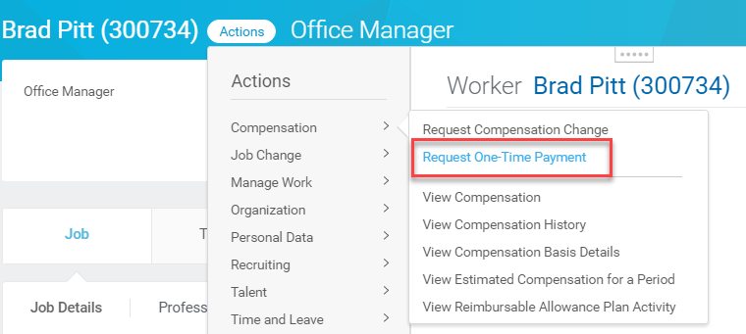
One-Time Payments: Request One-Time Payment for Canada Vacation
Click Actions
Hover over Compensation
Click Request One-Time Payment
Notes:
From the search bar, enter the “request one time payment” task. You can also access this task from the Employee’s profile by clicking Actions and hovering over Compensation. Click Request One-Time Payment from the drop-down menu.

Slide 10
One-Time Payments: Request One-Time Payment for Canada Vacation
Enter the effective date
Select the employee
Notes:
Enter the effective date and the employee name. Be sure to enter a date that is the Friday before the date checks are paid to employees.

Slide 11
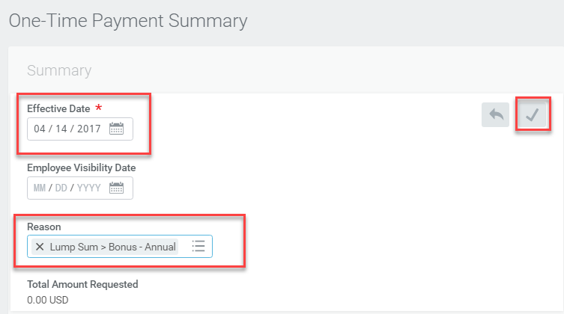
One-Time Payments: Request One-Time Payment for Canada Vacation: Payment Summary
Effective Date defaults
Select Vacation Dollars
Click to save updates
Notes:
The One-Time Payment Summary page displays. Click the Edit icon . The Effective date defaults which is the Friday prior to the check date. You may enter the Employee Visibility Date as the date the employee receives the funds on his/her paycheck. Select a reason for the one-time payment from the Reason field. Once done, click the Save icon

Slide 12
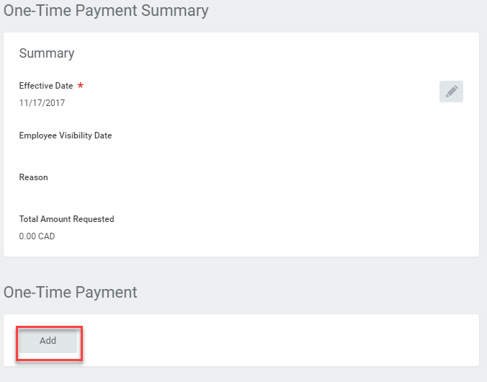
One-Time Payments: Request One-Time Payment for Canada Vacation: Payment Summary
Click Add to enter one-time payment details
Notes:
Once the summary information has been saved, enter the one-time payment details by clicking Add.

Slide 13
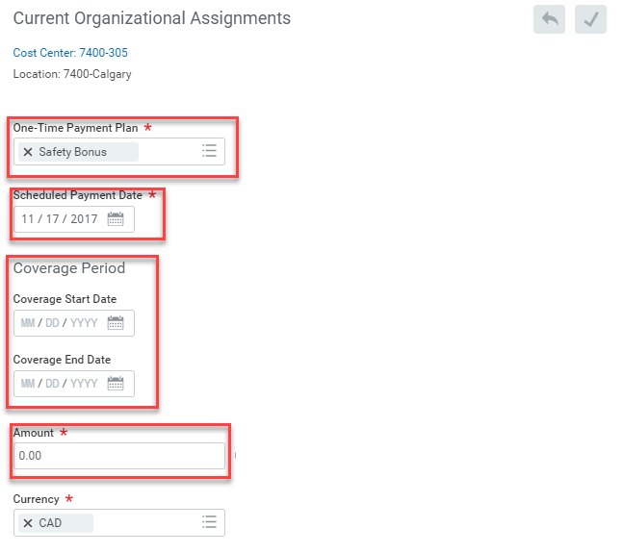
One-Time Payments: Request One-Time Payment for Canada Vacation: Payment Details
Choose the One-Time Payment Plan Vacation Dollars
The Scheduled Payment Date
is the same as the
Effective Date
Enter the coverage period for when you are paying the vacation. (for reporting purposes only, can be left blank)
Enter the amount of the
one-time payment
Notes:
Choose the One-Time Payment Plan type and enter the amount. Note that the Scheduled Payment Date is the same as the Effective Date. Remember, these dates need to be the Friday before the date checks are paid to employees.

Slide 14
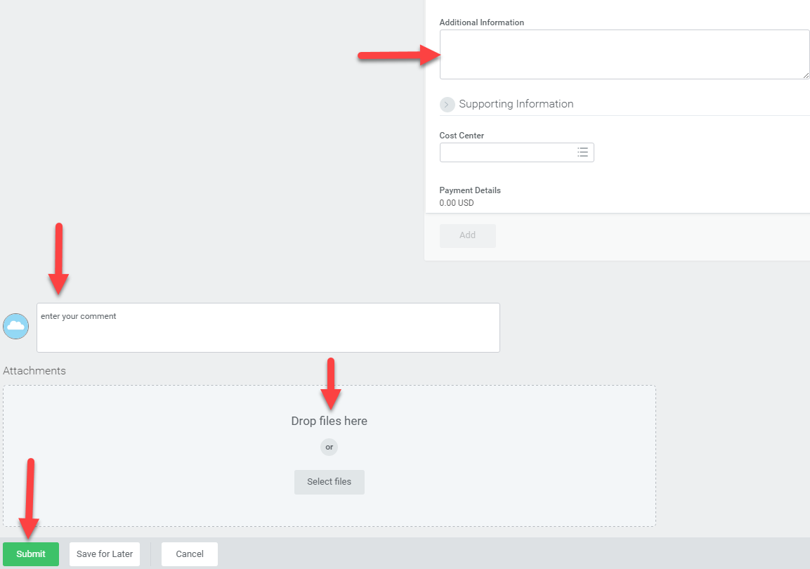
One-Time Payments: Request One-Time Payment for Canada Vacation: Payment Details
Add any relevant information regarding the one-time payment
Add any general information in the comments section
Attach any relevant files
Click Submit
Notes:
Use the Additional Information field for details relevant to the one-time payment and upload any supporting documentation required by your region. You may also add any general comments in the “enter your comment” section. Click Submit.

Slide 15
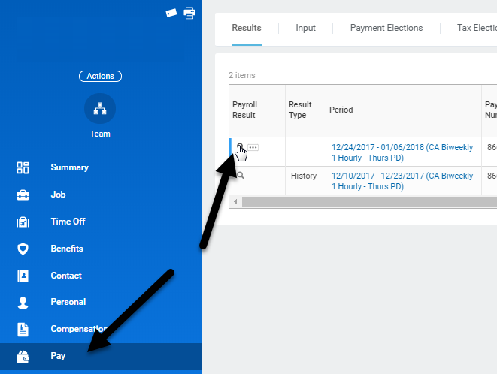
Viewing time off/vacation balances in Workday
There are several ways to review time off balances. Below are a few.
From pay results:
Notes:
Use the Additional Information field for details relevant to the one-time payment and upload any supporting documentation required by your region. You may also add any general comments in the “enter your comment” section. Click Submit.

Slide 16
Viewing time off/vacation balances in Workday cont..
Notes:
Use the Additional Information field for details relevant to the one-time payment and upload any supporting documentation required by your region. You may also add any general comments in the “enter your comment” section. Click Submit.

Slide 17
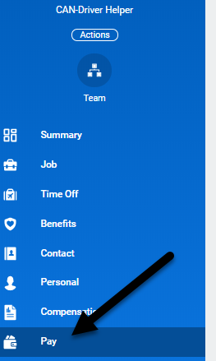
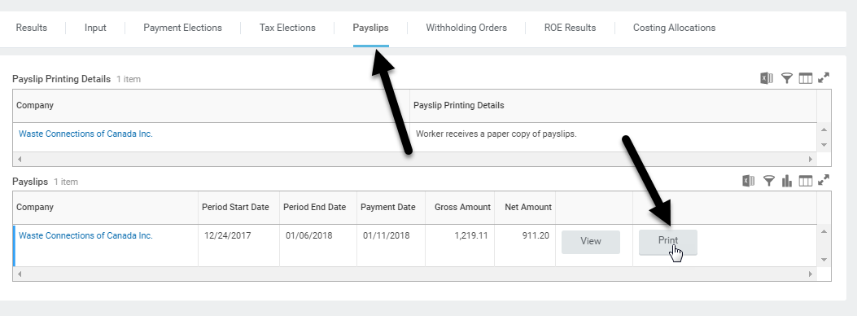
Viewing time off/vacation balances in Workday cont..
The second way to view the balances is from the actual printed paystub.
Notes:
Use the Additional Information field for details relevant to the one-time payment and upload any supporting documentation required by your region. You may also add any general comments in the “enter your comment” section. Click Submit.

Slide 18
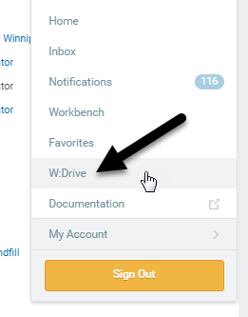
Viewing time off/vacation balances in Workday cont..
The printed paystub will appear in your W drive. The balances are at the bottom of the paystub.
Notes:
Use the Additional Information field for details relevant to the one-time payment and upload any supporting documentation required by your region. You may also add any general comments in the “enter your comment” section. Click Submit.

Slide 19
Resources
Job Aids Currently Available in the Learning Worklet:
Request Compensation Change
Process One-Time Payment Job Aid

